Slide 1
High Availability Cluster using Pacemaker
(Ensuring Continuous Availability for Critical Services)

Slide 2
Guided by
Mr. Roshan Gami
Presented by
Manisha Labade PRN : 230940127006
Poonam Watpade PRN : 230940127013
Diwan Chand PRN : 230940127033
Mukut Raj Verma PRN : 230940127042
Sampada Kokane PRN : 230940127046
Sneha Kisku PRN : 230940127055

Slide 3
High Availability Cluster Using Pacemaker
Ensuring continuous operation of critical services
Pacemaker is a widely-used open-source cluster resource manager that facilitates the implementation of HA configurations
Pacemaker achieving resilience and fault tolerance
Pacemaker's architecture, highlighting its ability to monitor resource states, manage failover events, and balance loads across clustered nodes
Deploying Pacemaker-based HA setups
Pacemaker empowers organizations to maintain service availability and minimize downtime

Slide 4
High Availability Cluster
Group of computers or nodes
Ensure service remains available and operational for users
Minimize downtime
Service continuity.

Slide 5
Features of Highly Available Clusters
• Detection and recovery of machine and application-level failures
• Supports practically any redundancy configuration
• Supports both quorate and resource-driven clusters
• Configurable strategies for dealing with quorum loss (when multiple machines fails)
• Supports application startup/shutdown ordering, regardless of which machine(s) the applications are on

Slide 6
Benefits of HA cluster
Redundancy
Communication
Load Balancing
Failover
Monitoring and Recovery
Scalability
Enhanced Reliability
Continuous Availability
Cost-Effectiveness

Slide 7
Configuration of a high availability cluster using Pacemaker
1. Node Setup
2. Resource Configuration
3. Resource Agents
4. Cluster Configuration
5. Resource Constraints
6.Testing and Monitoring

Slide 8
Total Machines Used For Formation Of High Availability Cluster
Properties | iSCSI | Node 1 | Node 2 | Node 3 | Virtual IP
OS | CentOS 7 | CentOS 7 | CentOS 7 | CentOS 7 | CentOS 7
vCPU | 1 | 1 | 1 | 1 | 1
Memory | 1GB | 1GB | 1GB | 1GB | 1GB
Disk | 20GB + 20GB | 30GB | 30GB | 30GB | 30GB
FQDN | https://ec2-65-0-131-40.ap-south-1.compute.amazonaws.com | https://ec2-13-201-190-82.ap-south-1.compute.amazonaws.com | https://ec2-13-232-74-191.ap-south-1.compute.amazonaws.com | https://ec2-13-110-174-149.ap-south-1.compute.amazonaws.com | https://ec2-13-233-192-88.ap-south-1.compute.amazonaws.com
Hostname | iSCSI.aws | node1.aws | node2.aws | node3.aws | virtual.aws
IP Address (Internal) | 172.31.7.159 | 172.31.2.149 | 172.31.2.26 | 172.31.2.51 | 172.31.10.4
IP Address (External) | DHCP | DHCP | DHCP | DHCP | DHCP

Slide 9
System Requirement
User Interface
EC2 Instance Centos 7 (t2 micro)
Software Requirement
AWS
Pacemaker
Hardware Requirement
Centos 7 (t2-micro) 30GB HD, 4 GB RAM
Used Languages
Shell Scripting
html

Slide 10
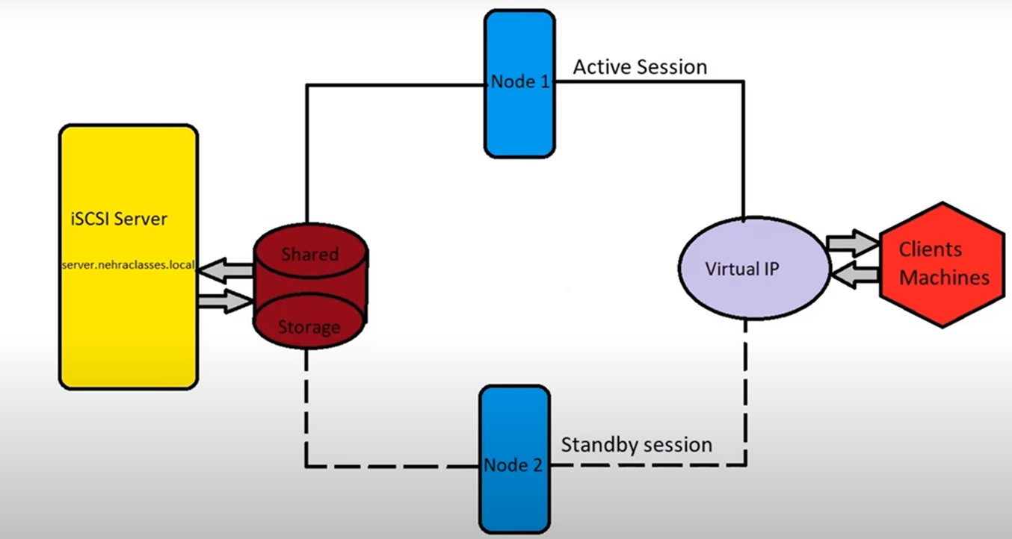
System Architecture

Slide 11
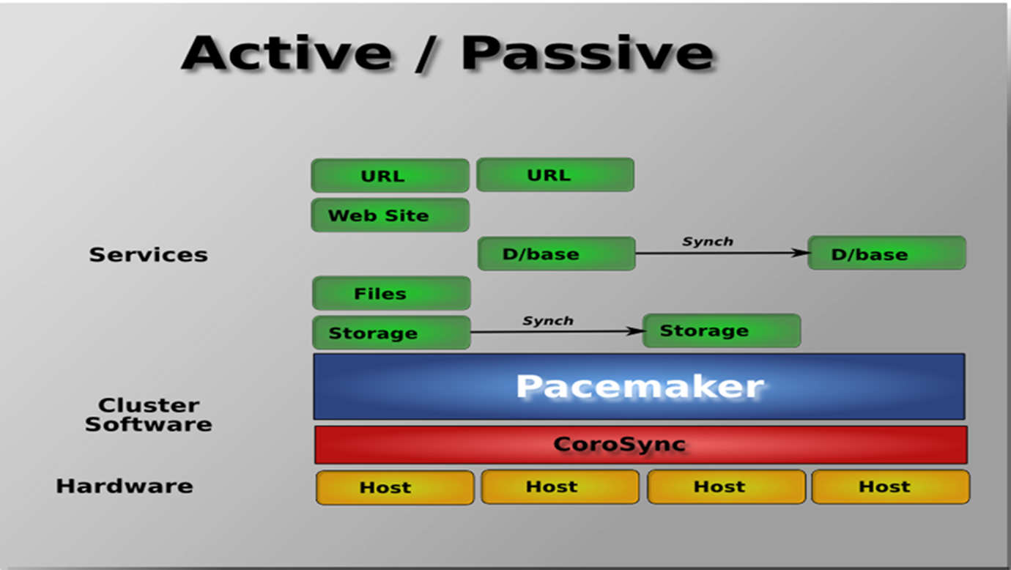
Process Flow Diagram

Slide 12
Amazon Elastic Compute Cloud (EC2)
"Amazon Elastic Compute
Amazon Elastic Compute Cloud (EC2)
"Amazon Elastic Compute Cloud (Amazon EC2) is an Amazon Web Service (AWS) you can use to access servers, software, and storage resources across the Internet in a self-service manner"
Provides scalable, pay as-you-go compute capacity
Elastic scales in both direction

Slide 13
Amazon's EC2 features
Elastic capacity
Elastic resource config/reconfig; Elastic num of instances
Completely Control
Root access/access to console output/data store/ reboot
Reliable
Multiple locations
Elastic IP addresses
Secure
Firewall config
Virtual Private Cloud
Performance
Auto Scaling
Auto local balancing

Slide 14
Amazon EC2 Concepts
■ Resizable compute capacity in the cloud
Obtain and boot new server instances in minutes
Quickly scale capacity, up or down, as your computing requirements change
■Full root access to a blank Linux machine
■ Simple Web service management interface
■Changes the economics of computing

Slide 15
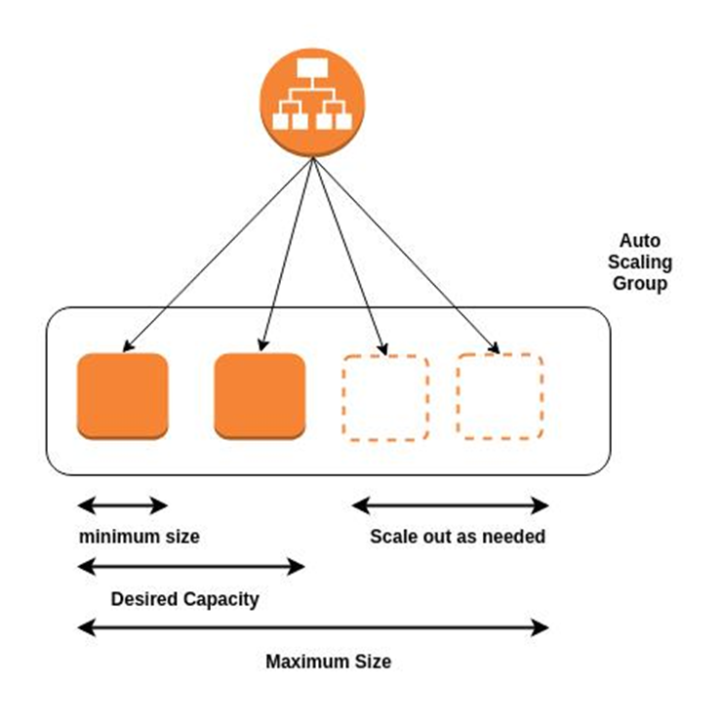

Slide 16
iSCSI
It is an Internet Protocol-based storage networking standard
It provides block-level access to storage devices
It enables the remote access of storage devices
It facilitates data transfers over intranets
Manage storage over long distances
It allows clients to send SCSI commands to storage devices

Slide 17
Pacemaker
Open-source, high-availability cluster resource manager
Provides automated management for groups of servers
Ensuring continuous availability of services
Co-ordinates the distribution of resources across multiple nodes in a cluster
Monitors cluster health
Ensures failover processes to maintain service uptime

Slide 18
Pacemaker architecture components
The following components form the Pacemaker architecture
Cluster Information Base (CIB)
Cluster Resource Management Daemon (CRMd)
Shoot the Other Node in the Head (STONITH)

Slide 19
High Availability Setup
Create an active/passive HA setup
The setup involves two Centos 7 servers
The primary (active) server handles traffic
The secondary (passive) server takes over if the primary fails

Slide 20
Configuration of high availability cluster using pacemaker
Install Pacemaker and Corosync
Network Configuration
Resource Agents
Create Cluster Configuration
Define Cluster Resources
Configure Resource Constraints
Start and Verify the Cluster
Testing Failover
Monitoring and Maintenance

Slide 21
Pacemaker configuration and management tools
pcs
controls and configures Pacemaker and the corosync heartbeat daemom
Create and configure a Pacemaker/Corosync cluster
Modify configuration of the cluster while it is running
Remotely configure both Pacemaker and Corosync
Start the cluster
Stop the cluster
Display status information of the cluster
pcsd Web UI
Graphical user interface to create and configure Pacemaker/Corosync clusters

Slide 22
Corosync
Open source program
Provides cluster membership and messaging capabilities
Enables servers to communicate as a cluster
Manages quorum rules and determination.
Provides messaging capabilities for applications
Uses the kronosnet library

Slide 23
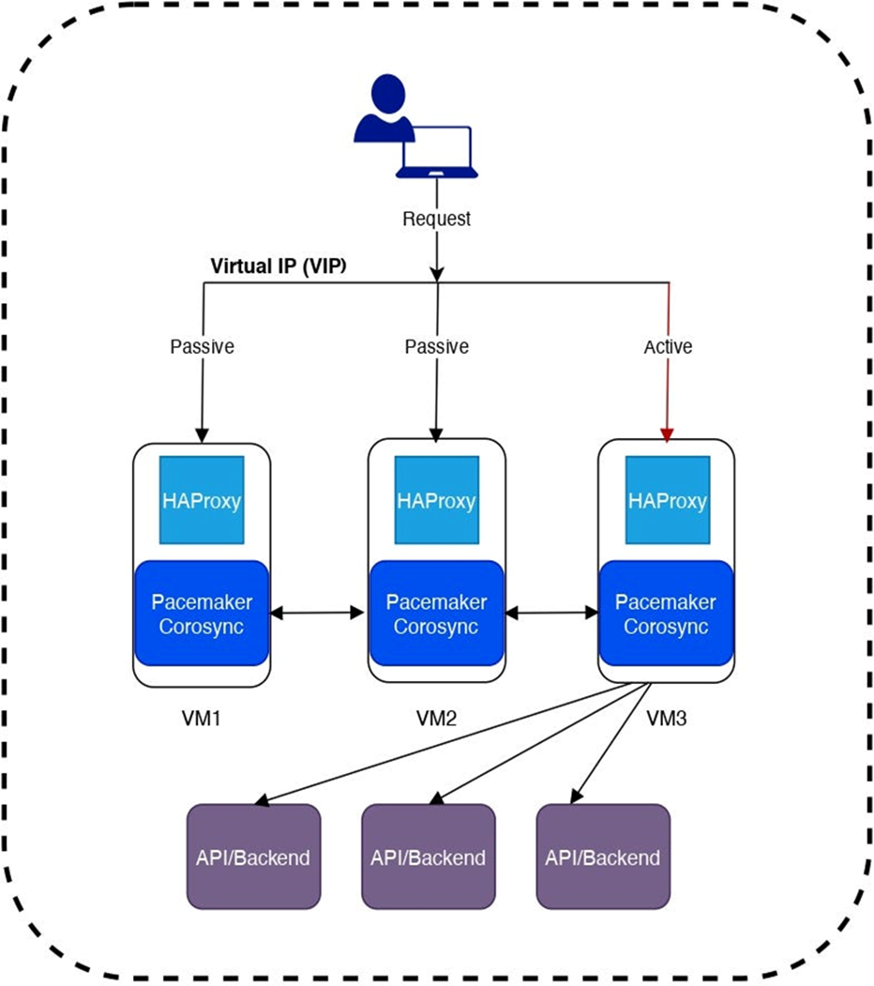
This figure explains how to setup Pacemaker/Corosync cluster for highly
available, scalable resource manager and HAProxy load balancer for splitting
traffic to backend.
Pacemaker/Corosync setup for Highly Available cluster

Slide 24
Technology stack
• HAProxy
• Pacemaker
A Pacemaker stack is built on five core components
libQB
Corosync
Resource agents
Fencing agents
Pacemaker
• Virtual IP

Slide 25
Conclusion
Ensuring the resilience and
Continuity of critical services,
Automating failover processes,
Managing resource effinciency,
Offering flexibility in configuration and
Mitigate the risk of downtime and
Maximize service uptime

Slide 26
Thank You !

